Slide 1
Compressor for JUCE

Slide 2
Compressor
Simple dynamic range compressor
With look-ahead using circular buffer

Slide 3
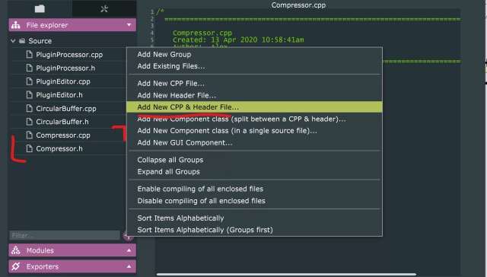
Set up
Create Compressor plugin with Projucer
Copy CircularBuffer files from Limiter tutorial to source folder
Select Add New CPP & Header File…
Create Compressor.cpp and Compressor.h files

Slide 4
Compressor Class
Add this base code to Compressor.h
Add these in private section of class
tav is averaging time used when calculating rms
Add one public function & constructor that takes no arguments
#include "CircularBuffer.h"
#pragma once
class Compressor {
public:
private:
};
CircularBuffer buffer;
float tav, rms, gain;
class Compressor {
public:
Compressor();
float compressSample(float data, float thresh, float ratio,
float attack, float release, float knee);
private:

Slide 5
Compressor class
Create definitions for the two functions in Compressor.cpp
in Compressor() constructor, initialise buffer and set default values
Compressor::Compressor()
{
buffer = CircularBuffer(150, 20);
tav = 0.01;
rms = 0;
gain = 1;
}
float Compressor::compressSample(float data, float thresh, float ratio,
float attack, float release, float knee)
{
}

Slide 6
How compressors work
Three main operations for compressor;
how loud incoming signal is
how much to reduce gain by
Based partly on compression ratio
smooth gain transition to avoid artefacts.

Slide 7
1. Gain Detector
Use peak detector to determine when to activate limiter
Now find RMS value of waveform
RMS is continous power of waveform over time.
Adjusts rms value depending on incoming signal
Converts this to decibel scale
float Compressor::compressSample(float data, float thresh, float ratio,
float attack, float release, float knee)
{
rms = (1 - tav) * rms + tav * std::pow(data, 2.0f); //1
float dbRMS = 10 * std::log10(rms); //2
return 0.0f;
}

Slide 8
2. Gain reduction
Users pick compression ratio
Calculate slope from ratio
Convert ratio to slope, 4:1 -> 0.75, 2:1 -> 0.5
Find dB gain to apply, make sure it’s less than 0
Multiply (threshold – dbRMS) by this slope factor
Make sure signal never boosted if rms value above threshold
Calculate newGain in linear scale
float Compressor::compressSample(float data, float thresh, float ratio,
float attack, float release, float knee)
{
…
float slope = 1 - (1 / ratio); //1
float dbGain = std::min(0.0f, (slope * (thresh - dbRMS))); //2
float newGain = std::pow(10, dbGain / 20); //3
return 0.0f;
}

Slide 9
3. Ballistics
Know what gain to apply to the current signal
Need to smooth transition to this new value
Use attack and release times
Declare coeff variable, if newGain is less than current gain set to attack variable
Else set to release
Adjust gain based on new gain and coeff
float Compressor::compressSample(float data, float thresh, float ratio,
float attack, float release, float knee)
{
…
float coeff;
if (newGain < gain) coeff = attack; //1
else coeff = release; //2
gain = (1 - coeff) * gain + coeff * newGain; //3
return 0.0f;
}

Slide 10
Finishing compressor class
Set and get values from our CircularBuffer.
float Compressor::compressSample(float data, float thresh, float ratio,
float attack, float release, float knee)
{
…
float compressedSample = gain * buffer.getData();
buffer.setData(data);
buffer.nextSample();
return compressedSample;
}

Slide 11
Coding PluginProcessor
We have working Compressor class, but not using it
Go to PluginProcessor.h.
Include new Compressor class at top of file
declare new array of Compressors.
#include <JuceHeader.h>
#include "Compressor.h"
…
private:
juce::Array<Compressor> allCompressors;
juce::AudioProcessorValueTreeState state;

Slide 12
Coding PluginProcessor
Create array of Compressors
in PluginProcessor.cpp
It is now compressing the input signal
// prepareToPlay
for (int channel = 0; channel < getNumOutputChannels(); channel++) {
allCompressors.add(Compressor());
}
// processBlock
for (int i = 0; i < buffer.getNumSamples(); i++) {
for (int channel = 0; channel < getTotalNumOutputChannels(); channel++) {
auto* data = buffer.getWritePointer(channel);
Compressor* comp = &allCompressors.getReference(channel);
data[i] = comp->compressSample(data[i], -30.0f, 20.0f, 0.01f, 0.4f, 0.0f);
}
}
Loop through samples and channels
Get reference Compressor for current channel
Compress samples by passing initial values to compressSample function

Slide 13
Value Trees for the User Interface
ValueTreeState to make GUI, save & recall plugin state, add DAW parameter automation
Editor access & edit it
Processor only reads it
Declare AudioProcessorValueTreeState named state in PluginProcessor.h
Add constructor in AudioProcessor Constructor list & parameters to StateTree in constructor
// PluginProcessor.h
juce::Array<Compressor> allCompressors;
juce::AudioProcessorValueTreeState state;
// PluginProcessor.cpp
CompressorAudioProcessor::CompressorAudioProcessor()
#ifndef JucePlugin_PreferredChannelConfigurations
: AudioProcessor (BusesProperties()
#if ! JucePlugin_IsMidiEffect
…
#endif
)
, state(*this, nullptr, Identifier("params"), { })

Slide 14
Using Value Trees for the User Interface
Create unique pointer to AudioParameterFloat with identifier thresh, name Threshold, numberRange -60.0f -> 20.0f, spacing 0.01f, default 10.0f
Similarly for other parameters
, state(*this, nullptr, Identifier("params"), {
std::make_unique<AudioParameterFloat>(
"thresh", "Threshold", NormalisableRange<float>(-60.0f, 20.0f, 0.01f), 10.0f),
std::make_unique<AudioParameterFloat>(
"ratio", "Ratio", NormalisableRange<float>(1.0f, 20.0f, 0.01f), 2.0f),
std::make_unique<AudioParameterFloat>(
"knee", "KneeWidth", NormalisableRange<float>(0.0f, 24.0f, 0.01f), 0.0f),
std::make_unique<AudioParameterFloat>(
"attack", "Attack", NormalisableRange<float>(0.01f, 500.0, 0.01f), 100.0f),
std::make_unique<AudioParameterFloat>(
"release", "Release", NormalisableRange<float>(0.01f, 2000.0f, 0.01f), 500.0f)
})

Slide 15
Pass Value Tree State to Plugin Editor
Value Tree State now setup in PluginProcessor
Pass it into PluginEditor
In PluginEditor.h, declare pointer to AudioProcessorValueTreeState called params
Change constructor to receive AudioProcessorValueTreeState object
class CompressorAudioProcessorEditor : public juce::AudioProcessorEditor
{
public:
CompressorAudioProcessorEditor (CompressorAudioProcessor&,
AudioProcessorValueTreeState&);
…
private:
CompressorAudioProcessor& audioProcessor;
AudioProcessorValueTreeState& params;

Slide 16
Pass Value Tree State to Plugin Editor (II)
In PluginEditor.cpp edit constructor to receive state object and point params to state
CompressorAudioProcessorEditor::CompressorAudioProcessorEditor (CompressorAudioProcessor& p, AudioProcessorValueTreeState& state)
: AudioProcessorEditor (&p), audioProcessor (p), params(state)
{
setSize (400, 300);
}
In PluginProcessor.cpp change editor constructor to include passing Value Tree
juce::AudioProcessorEditor* CompressorAudioProcessor::createEditor()
{
return new CompressorAudioProcessorEditor (*this, state);
}

Slide 17
Create sliders to control tree values
In PluginEditor.h create this typedef at top of file
Saves writing AudioProcessorValueTreeState::SliderAttachment every time.
Declare sliders, labels and slider attachments
slider attachment allows values in stateTree to be changed by a slider
#include "PluginProcessor.h"
using namespace juce;
typedef AudioProcessorValueTreeState::SliderAttachment SliderAttachment;
…
AudioProcessorValueTreeState& params;
Slider threshSlider, slopeSlider, kneeSlider, attackSlider, releaseSlider;
Label threshLabel, slopeLabel, kneeLabel, attackLabel, releaseLabel;
std::unique_ptr<SliderAttachment> slopeAttachment, kneeAttachment, attackAttachment,
releaseAttachment, thresholdAttachment;
JUCE_DECLARE_NON_COPYABLE_WITH_LEAK_DETECTOR (CompressorAudioProcessorEditor)

Slide 18
Create sliders to control tree values
Add following to PluginEditor
declare private in header file as it won’t be called elsewhere.
void CompressorAudioProcessorEditor::addSlider(
String name, String labelText,
Slider& slider, Label& label,
std::unique_ptr<SliderAttachment>& attachment)
{
addAndMakeVisible(slider);
attachment.reset(new SliderAttachment(params, name, slider));
label.setText(labelText, dontSendNotification);
label.attachToComponent(&slider, true);
addAndMakeVisible(label);
}

Slide 19
Create sliders to control tree values
Add sliders, labels and attachments to GUI & attach them to Value Tree
Put this code in Editor constructor
addSlider("thresh", "Threshold", threshSlider, threshLabel, threshAttachment);
addSlider("ratio", "Ratio", slopeSlider, slopeLabel, slopeAttachment);
addSlider("knee", "Knee", kneeSlider, kneeLabel, kneeAttachment);
addSlider("attack", "Attack", attackSlider, attackLabel, attackAttachment);
addSlider("release", "Release", releaseSlider, releaseLabel, releaseAttachment);
setSize (400, 300);
Set bounds of slider components in resized() function
threshSlider.setBounds(100, 0, 200, 50);
slopeSlider.setBounds(100, 50, 200, 50);
kneeSlider.setBounds(100, 100, 200, 50);
attackSlider.setBounds(100, 150, 200, 50);
releaseSlider.setBounds(100, 200, 200, 50);

Slide 20
Use slider values in Plugin Processor
Declare these pointers in header file
Set them to Value Tree values in prepareToPlay
Pointers don’t directly store float value
point to memory address where value stored
// PluginProcessor.h -> class CompressorAudioProcessor (private)
std::atomic<float> *threshParam, *slopeParam, *kneeParam,
*attackParam, *releaseParam;
// PluginProcessor.cpp -> PrepareToPlay
threshParam = state.getRawParameterValue("thresh");
slopeParam = state.getRawParameterValue("ratio");
kneeParam = state.getRawParameterValue("knee");
attackParam = state.getRawParameterValue("attack");
releaseParam = state.getRawParameterValue("release");

Slide 21
Process block
Pass these values to processBlock
Convert attack and release times from seconds to milliseconds & linear to time scale
float at = 1 - std::pow(MathConstants<float>::euler,
((1 / getSampleRate()) * -2.2f) / (*attackParam / 1000.0f));
float rt = 1 - std::pow(MathConstants<float>::euler,
((1 / getSampleRate()) * -2.2f) / (*releaseParam / 1000.0f));
for (int i = 0; i < buffer.getNumSamples(); i++) {
for (int channel = 0; channel < getTotalNumOutputChannels(); channel++) {
auto* data = buffer.getWritePointer(channel);
Compressor* comp = &allCompressors.getReference(channel);
data[i] = comp->compressSample(data[i], *threshParam, *slopeParam,
at, rt, *kneeParam);
}
}

Slide 22
Set State and Get State
add code to save & recall StateTree,
change 2 functions in PluginProcessor.cpp
Now Compressor parameters saved when you stop using it & recalled when back.
void CompressorAudioProcessor::getStateInformation(juce::MemoryBlock& destData)
{
auto stateTree = state.copyState();
std::unique_ptr<XmlElement> xml(stateTree.createXml());
copyXmlToBinary(*xml, destData);
}
void CompressorAudioProcessor::setStateInformation(const void* data, int sizeInBytes)
{
std::unique_ptr<XmlElement> xmlState(getXmlFromBinary(data, sizeInBytes));
if (xmlState.get() != nullptr && xmlState->hasTagName(state.state.getType()))
state.replaceState(ValueTree::fromXml(*xmlState));
}

Slide 23
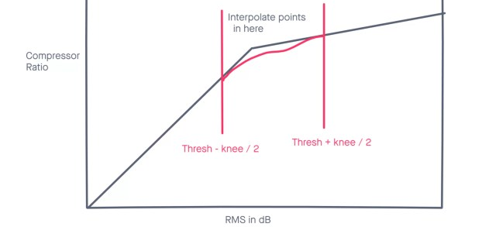
Adding a Soft Knee (OPTIONAL)
Hard knee → when an RMS is detected above threshold, ratio reset instantaneously
Create soft knee by introducing area where slope changed along curve. Gives compressor more natural, subtle effect on the sound
Many ways to interpolate between two points but we use lagrange interpolation
First we write a function to do this in Compressor.cpp

Slide 24
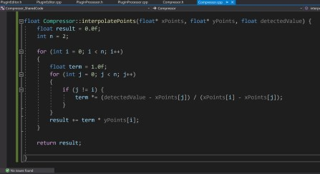
Adding a Soft Knee (OPTIONAL)
float Compressor::interpolatePoints(float* xPoints, float* yPoints, float detectedValue) { float result = 0.0f; int n = 2; for (int i = 0; i < n; i++){ float term = 1.0f; for (int j = 0; j < n; j++{ if (j != i) { term *= (detectedValue-xPoints[j])
/ (xPoints[i]-xPoints[j]); } }
result += term * yPoints[i];
} return result; }
This function takes array of 2 xpoints, 2 y points & approximates value between them. This value will replace our slope value

Slide 25
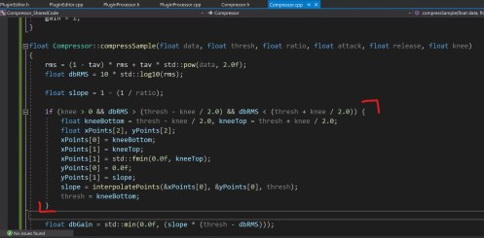
if (knee > 0 && dbRMS > (thresh - knee / 2.0) && dbRMS < (thresh + knee / 2.0)) { float kneeBottom = thresh - knee / 2.0, kneeTop = thresh + knee / 2.0; float xPoints[2], yPoints[2]; xPoints[0] = kneeBottom; xPoints[1] = kneeTop; xPoints[1] = std::fmin(0.0f, kneeTop); yPoints[0] = 0.0f; yPoints[1] = slope; slope = interpolatePoints(&xPoints[0], &yPoints[0], thresh); thresh = kneeBottom; }
This sets up some variables for the interpolation function we just wrote.
First it checks the current rms value is in the knee zone, between thresh – knee / 2.0 and thresh + knee / 2.0.
Then we make two arrays of points, xPoints holds db values of bottom and top of knee region. yPoints hold slope values.
Once these arrays are set up we interpolate new slope value and set threshold of compressor to the lower knee value

